Slide 1


STRESS MANAGEMENT
By Aqsa Fayyaz
Lecture 11

Slide 2


Understanding what is
Identify stress triggers and implement de-escalation strategies
Demonstrate the ability to manage stress

Slide 3
Interpretation of online test
Scores ranging from 0-13 would be considered low stress.
Scores ranging from 14-26 would be considered moderate stress.
Scores ranging from 27-40 would be considered high perceived stress
https://www.bemindfulonline.com/test-your-stress

Slide 4


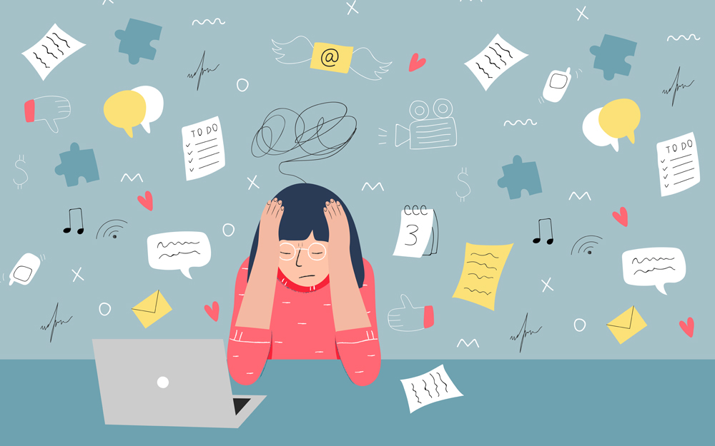
STRESS
“Stress can be defined as our mental, physical, emotional, and behavioral reactions to any perceived demands or threats”

Slide 5

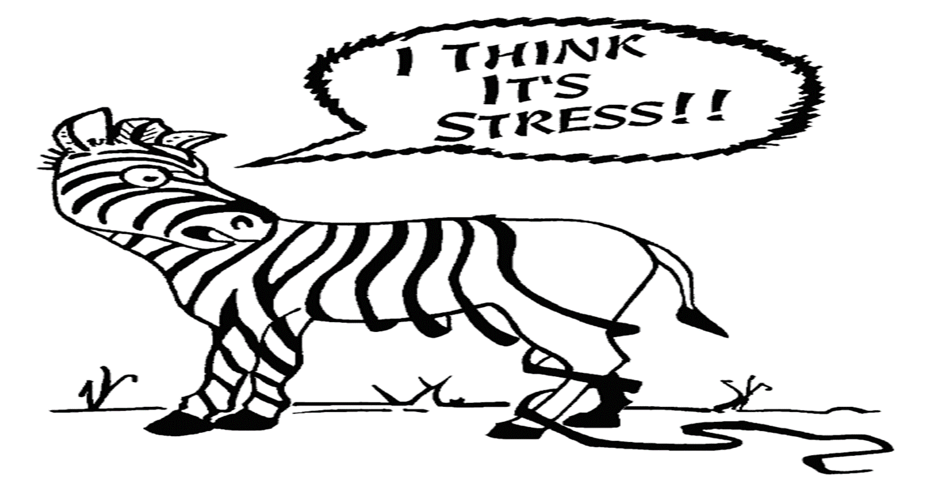

Why do we feel "Stress Out"?
For two major reasons:
We perceive a situation as threatening, difficult, or painful.
We don't believe we have the resources to cope.
1. The unsettling effects of change
2. The feeling that an outside force is challenging or threatening you
3. The feeling that you have lost personal control.

Slide 6
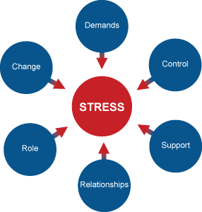
Stressors
There are many circumstances or events that can produce stress. The sources of stress are called stressors.
We will consider 3 types of stressors
1- Frustration (Blocking of goal directed
behavior) – light went off during paper.
Example: being stuck in a traffic jam can be very frustrating.

Slide 7
2-Conflict induced stress. When some goals can be satisfied on the expense of others.
Example: You can only buy one ice-cream out of two.
3- Life induced stress Life events that can be stressful
Example: Marriage, death of a loved one, divorced, change of schools, trouble with boss etc.

Slide 8
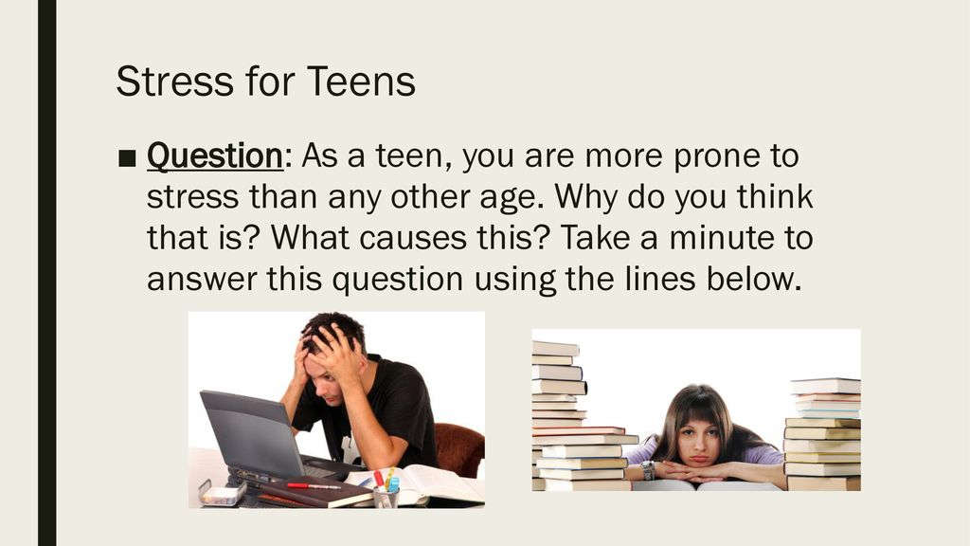

Slide 9


Causes of Stress in student life:
The National Institute of Mental Health (NIMH) notes some of the more common stressors for college students:
Increased academic demands
Being on your own in a new environment
Changes in family relations
Financial responsibilities
Changes in your social life
Exposure to new people, ideas, and temptations
Preparing for life after graduation.
Not getting enough sleep
Being lonely
Too many things to do

Slide 10
Stress as a physiological Reaction: Han Selye’s GAS (General adaptation syndrome)
Stressors produce a series of physiological reactions within us.
The reaction to stressors occur in three stages
1. Alarm (Any noticeable or rapid changes in the sympathetic system- Increased heart beat, increase blood pressure).
Your body goes into the “Fight or Flight Responses.” Your body prepares you to either fight the stressor or take flight and escape the stressor.
2. Resistance ( the cause of ones stress remains present due to which a person becomes sensitive to new stressors, resulting in becoming vulnerable to physical illnesses and exhaustion).
Body cannot restore homeostasis, and the body functions at a higher than normal level.
You may become weaker, tired and unable to handle more stress

Slide 11
3. Exhaustion: When no useful way to deal with the stress is present, this results in exhaustion.
At this stage all bodily energy is used which results in breaking down physically or psychologically or both.
With your body off balance, you are now more prone to illness, as your immune system is not able to fight.
This stage only happens if your body is continually fighting a stressor (usually months or years).

Slide 12
Example
Zehra is a college student in the middle of her semester , she is strongly motivated to do well in her semester. One day she receives a call from her home that her friend is admitted in hospital
She leaves college and drives for 16 hour to hospital. Her friend is admitted ,the shock and disbelief is very overwhelming for zehra’s initial alarm stage reaction.
Resistance stage: As her friend shows signs of recovery, but still will be admitted in the hospital for 3 days. There is little help zehra can do about it and she feels she cant leave the situation and go back to college now. Every day she stays at hospital, she gets further behind in her classes.

Slide 13
Example
Zahra becomes more sensitive to her problems as she feels stuck. With time, as She becomes vulnerable to physical disease or infections like respiratory difficulties, skin rashes high BP.
If Zehra can not find any useful way to deal with the stress she is experiencing, her physical reaction on the still-present stressors may be exhaustion. At this stage, her bodily resources are nearly depleted. She is running out of time and energy. She may break down psychologically-example depression or physically or both. In extreme situations if the exhaustion stage remains for a long time like years , can lead to death

Slide 14

How stress affects your brain.
Notes:
https://www.youtube.com/watch?v=WuyPuH9ojCE

Slide 15
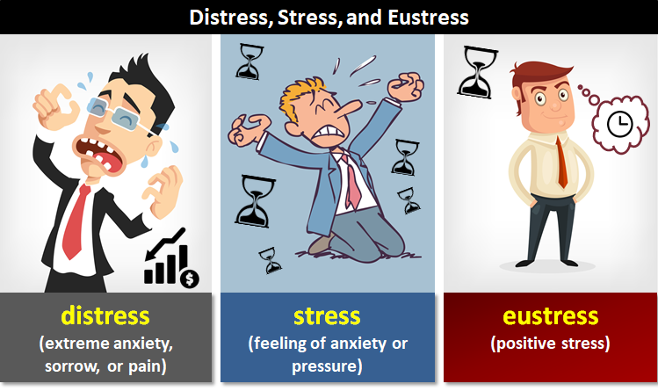
TYPES OF STRESS
EUSTRESS: Stress that is deemed healthful or giving one the feeling of fulfillment. when it helps to produce personal growth or accomplishment.
“Research has shown that moderate levels of stress can actually improve your ability to concentrate and perform at your best.”
DISTRESS: Stress that causes pain, suffering, trouble, danger, etc.

Slide 16
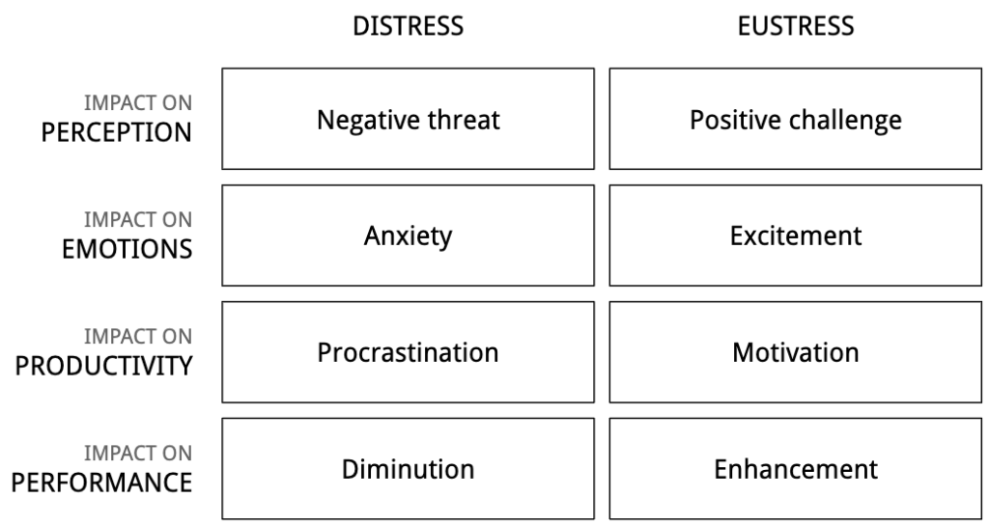

Slide 17
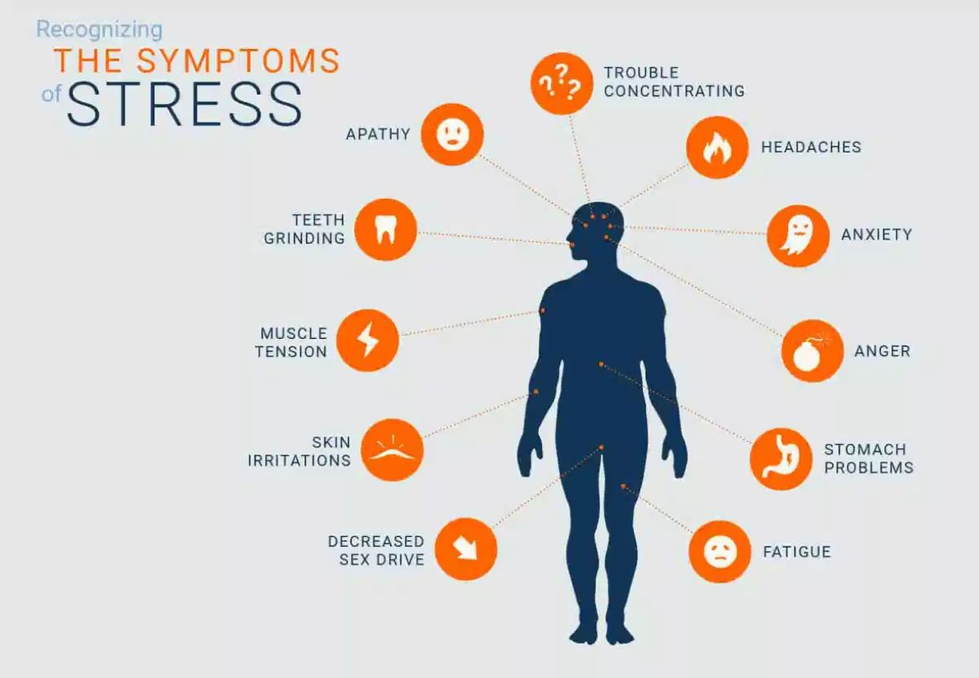
Symptoms of Distress
Headaches
Fatigue
Gastrointestinal problems
Hypertension (high blood pressure)
Heart problems, such as palpitations
Inability to focus/lack of concentration
Sleep disturbances, whether it’s sleeping too
much or an inability to sleep
Sweating palms/shaking hands
Anxiety

Slide 18
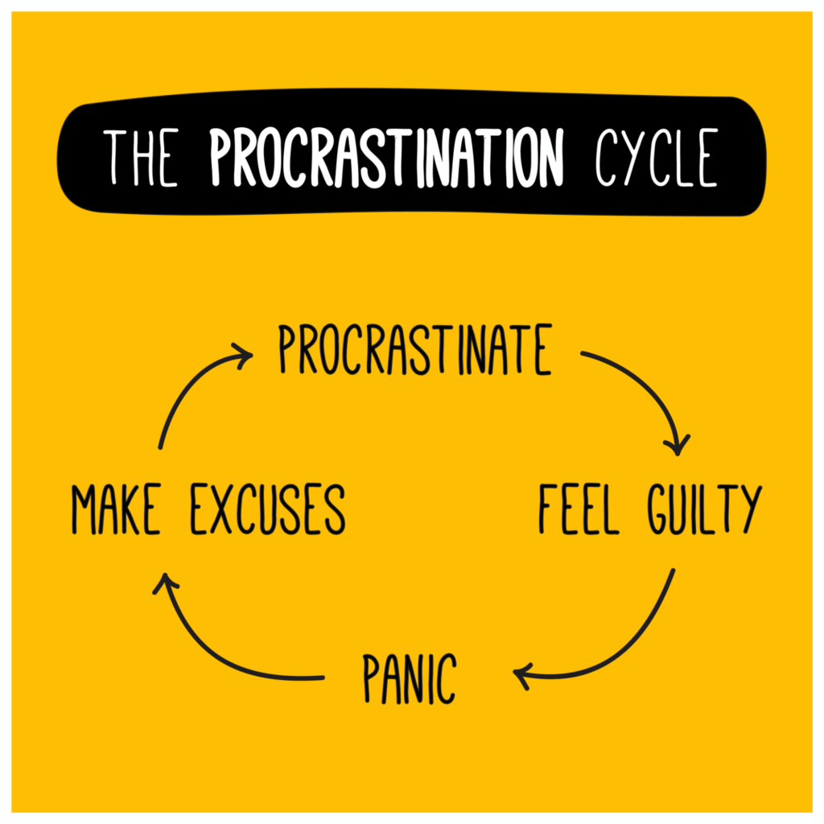
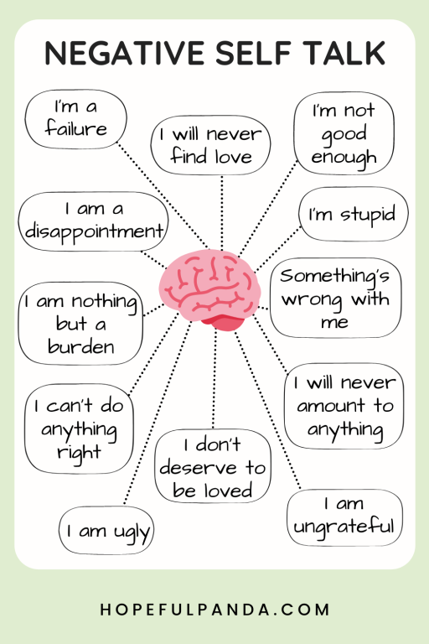
Ineffective strategies to deal with stressors
Procrastination
Aggressive behavior

Slide 19
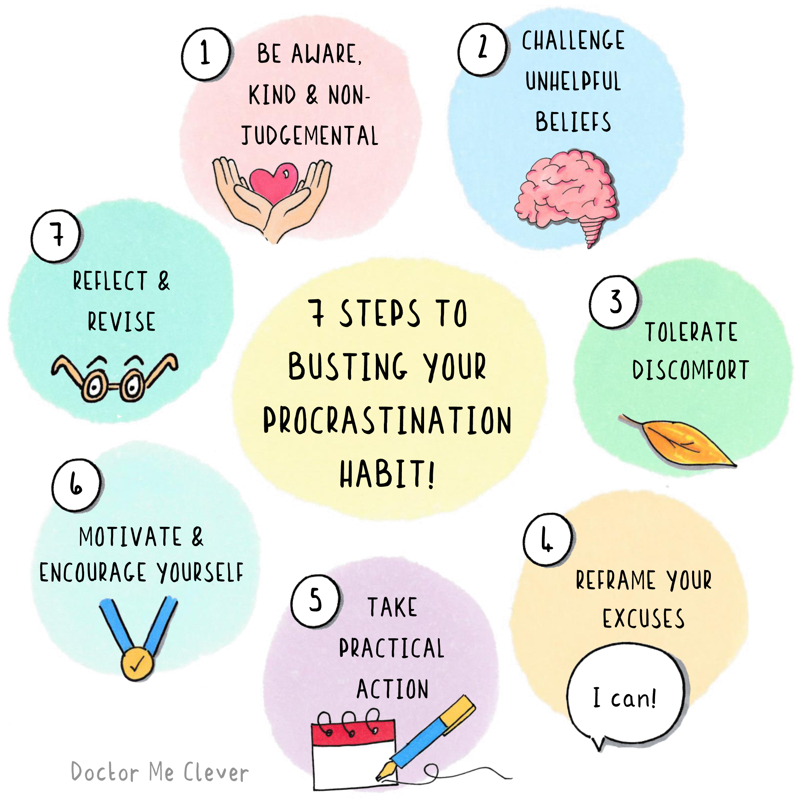

Slide 20
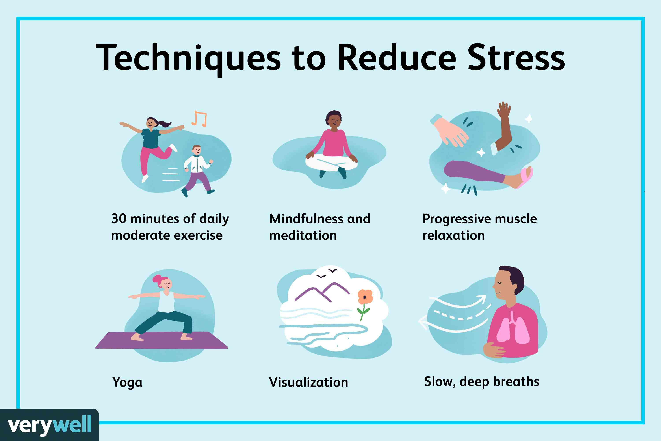
Effective strategies for coping with stressors
Identify the stressor
Remove the stressor
Reappraise the situation
Learn techniques of relaxation
Engage in physical exercise
Seek social support

Slide 21
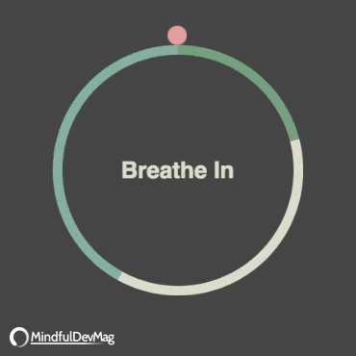

Slide 22

Anger Management

Slide 23

Learning outcomes
1. Define anger
2. What causes anger?
3. Anger vs. Aggression.
4. Learning about physical symptoms of anger
5. Anger triggers
6. Dealing with anger effectively

Slide 24


What is Anger?

Slide 25
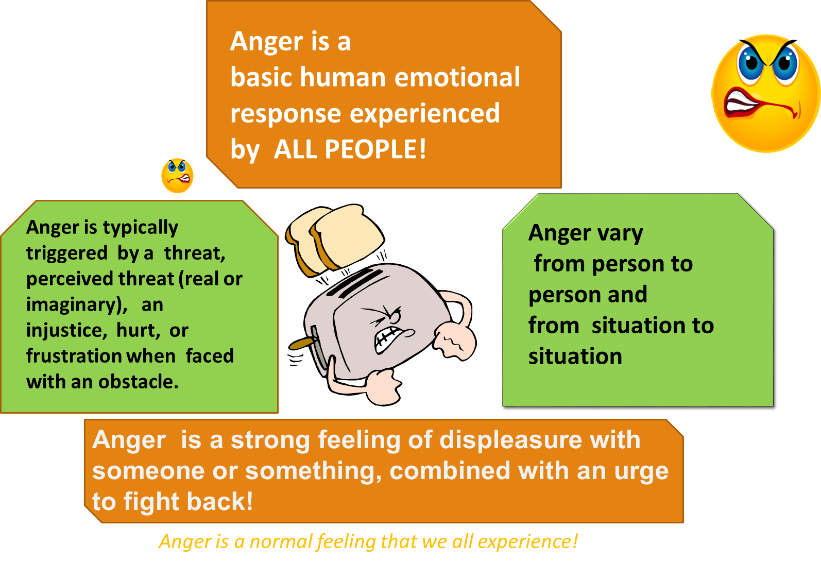

Slide 26
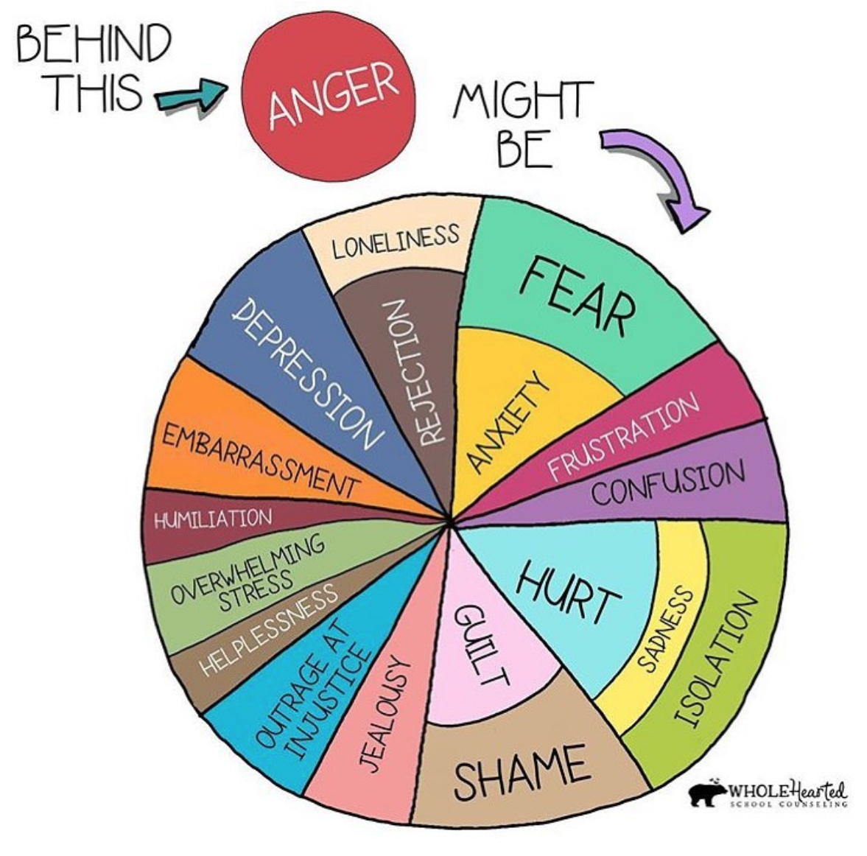

Slide 27
2. Anger (Feeling) vs. Aggression (Action)
Know the difference between anger and aggression.
Aggression is one negative way in which individuals express anger
Aggression cause damage with words, fists, or weapons, but it is virtually always designed to punish.
Aggression is intended to threaten or injure the victim’s security or self-esteem
“You can express your anger without being verbally or physically abusive.”
Notes:
Natural ways to express anger is to respond Aggressively. Anger often inspires powerful, often aggressive feelings and behaviors – that allow us to fight and defend ourselves when we are attacked. It is extremely important to recognize the difference between anger and aggression. Although the two are similar and may occur together, anger is an emotion that may result from frustration, fear, stress, annoyance, low-self-esteem disappointment and resentment; aggression is a negative act intended to hurt someone or something. Anger can sometimes feel intense and overwhelming but it does not necessarily lead to violent or aggressive behavior.

Slide 28
TRIGGERS What bugs you?
Different things can make different people angry, but everyone feels angry sometimes.

Slide 29
ACTIVITY

Slide 30
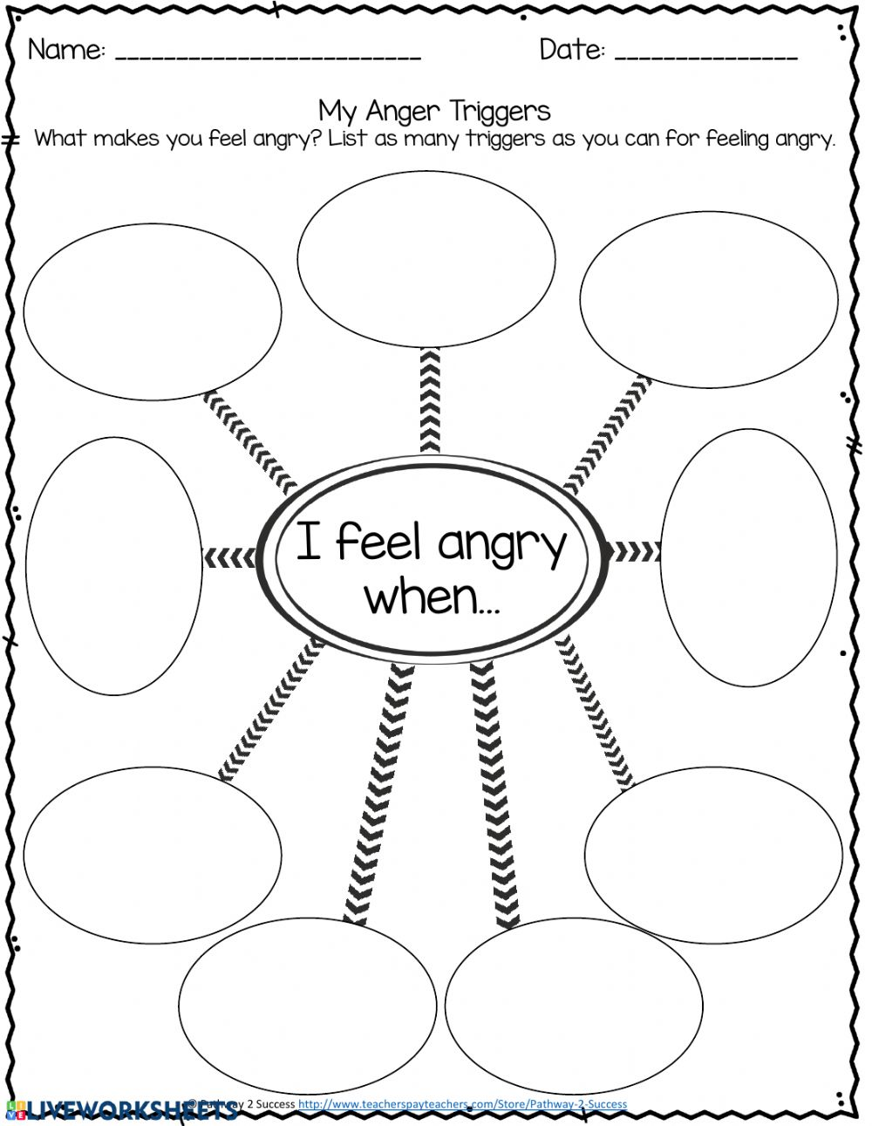
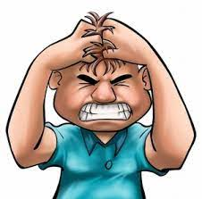
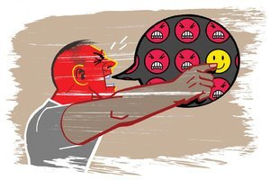
What are the things which make you angry?

Slide 31
Anger – Producing Situations
Specific person (s) or Event
Insults
Stress and Worries
Disappointment / Annoyance
Fears, Resentment, Frustration
Rejection / Hurt / Embarrassment
Having possessions taken or broken
Jealousy
Being teased or talked about
Low-Self Esteem
Grief
Home Life

Slide 32
Anger is a problem
When it harms you
When it leads to aggression
When it harms People around you
When it disrupts school or relationships
When it is too frequent, intense and lasts long
When it harms effects your overall quality of life
When chronic, explosive anger spirals out of control
Uncontrolled Anger can trigger a large number of anti-social behaviors and negative consequences””
Notes:
Anger may do more harm than any other emotion. It upsets at least two people – the aggressor and the aggressed against.
The overall effects of anger are enormous: anger is related to violence, crime, spouse and child abuse, divorce, stormy relationships, poor working conditions, poor physical health – headaches, hypertension, GI disturbances, heart attacks, emotional disorders and so on.

Slide 33

Consequences of ACTING OUT
Can lead to legal troubles
Can lead to problems at school / home / community
Relationships Problems
Substance Abuse
Physical Problems
Emotional Problems
Low Self Esteem
Others

Slide 34

ANGER CUES
Clenched fist
Racing & pounding heartbeat
Loud voice
Your body sends you signals, when you’re getting angry.
Red face
Upset stomach
Sweat
Notes:
What are your anger cues?

Slide 35
Dealing With Anger
Cool off, stay calm.
Walk away
Count to 10
Take deep breaths
Use calming self-talk: “I can handle this. Chill. It’s not as bad as it seems.”
Imagine you are in a peaceful place.

Slide 36
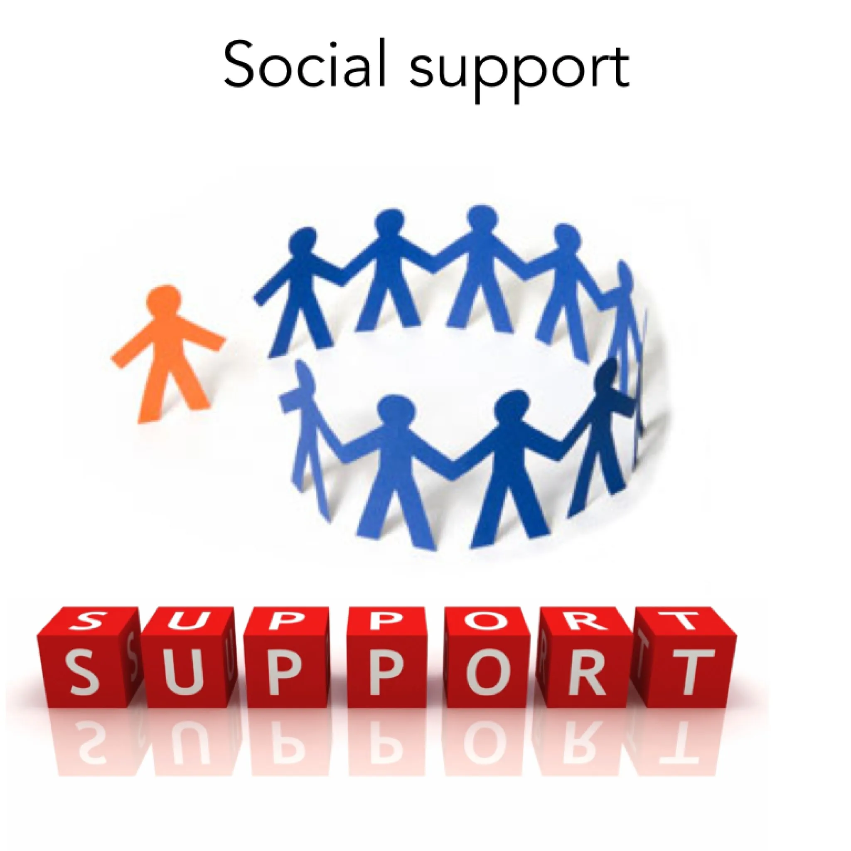
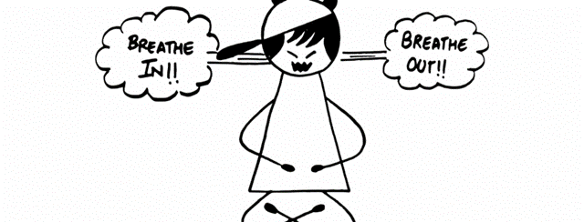
2. Give yourself some time to sort things out.
Write the problem down on paper.
Think it through. Ask yourself: what really happened? How was I triggered? What were my cues?
Talk it over with a friend or adult you trust.
Look at the situation from a different viewpoint.

Slide 37
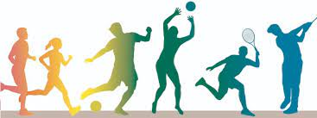
Turn your angry energy into a change for the better
Channel your angry energy into a physical activity.
Try to solve the problem.
Try to accept situations you can’t change.
Changing our view of a situation can change our reaction to it.
“Don’t let anger control you, take control over it”

Slide 38
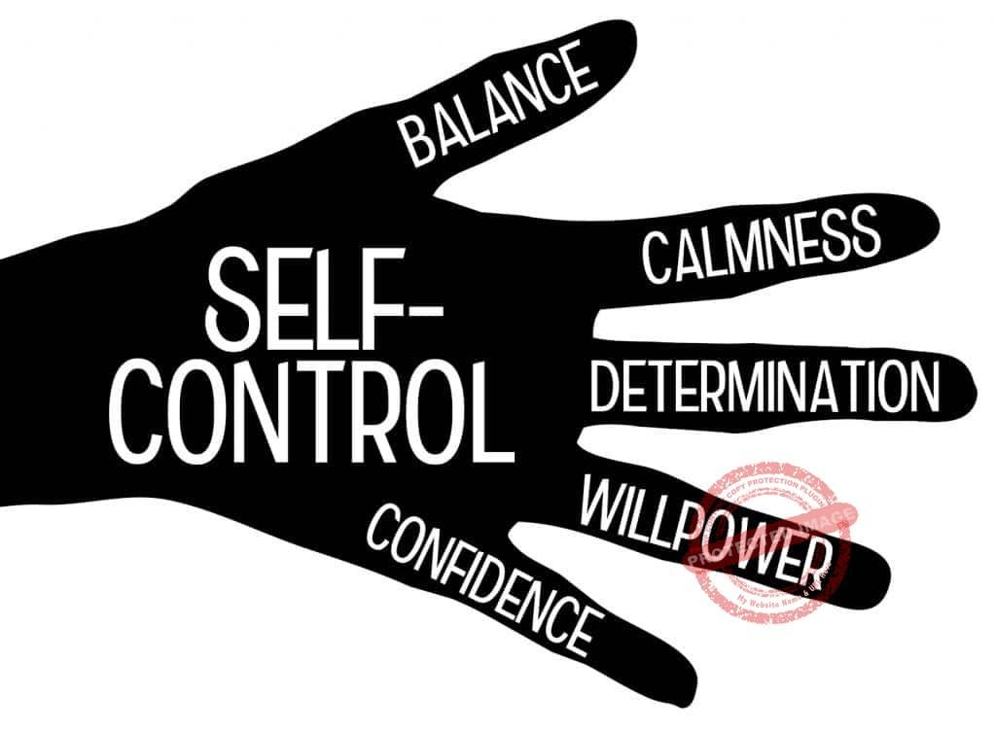
Exercise Self-Control
Self-Control is the ability to resist
inappropriate behavior, dealing effectively
with emotions, such as anger and developing patience.
Maintaining Self-Control is key to Managing Anger

Slide 39
How can I control my anger long term?
If you think about how to manage your anger when you're feeling calmer, you can avoid feeling overwhelmed by it in the heat of the moment.
In particular, you can:
learn your cues, practice and practice the skills
examine your thought patterns
develop your communication skills
look at your lifestyle

Slide 40
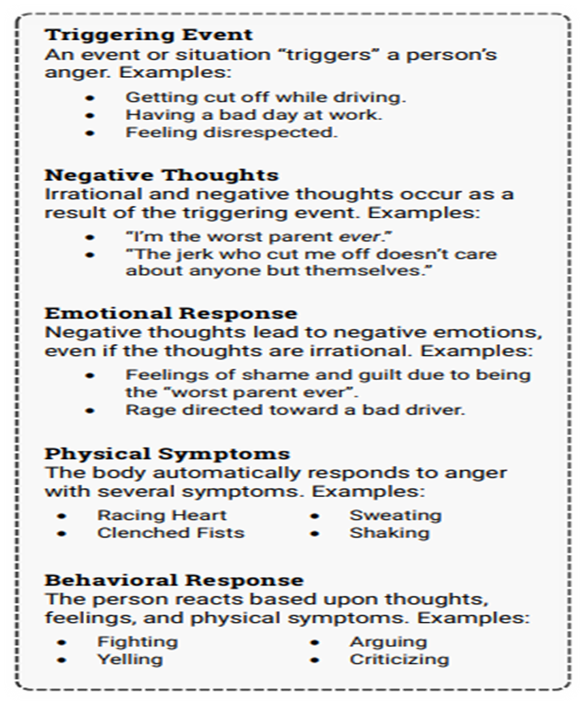
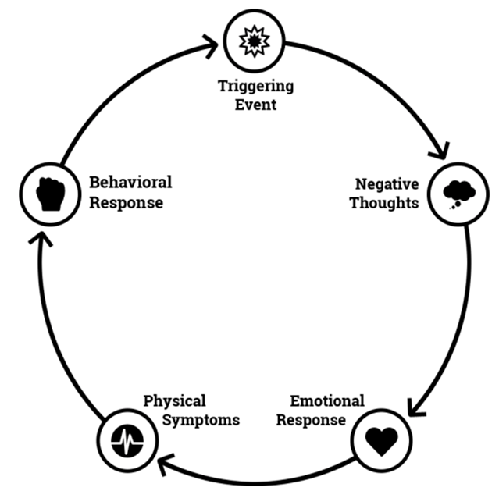
Anger Cycle:
This anger worksheet uses the CBT model to explain how anger grows from irrational thoughts, and leads to a difficult-to-break cycle of growing frustration.

Slide 41


